Slide 1
COURSERA CAPSTONE PROJECT
THE BATTLE OF THE NEIGHBOURHOODS-PRESENTATION
Opening a new Indian Sweet Shop
in Delhi, India
Prepared by: Akshat Kumar
Place: India

Slide 2
INTRODUCTION
When it comes to Indian Cuisine and food one thing cannot be overlooked is Indian’s love for Sweets. It’s not uncommon to see huge crowds at Sweet stores across the Country. And with the variety and sheer number of sweets available it's no wonder that it's such an important part of an Indian's lives.
The objective of this capstone project is to analyse and select the best locations that are available in Delhi, India to open a new Indian Sweet Shop .
Sweet Shop chain owners, Businessman and some entrepreneurs would be interested in knowing the location in the city like Delhi, India which is densely populated and have a great scope to open a Sweet Shop and flourish them in near future.

Slide 3
DATA
List of neighbourhoods in Delhi. This defines the scope of this project which is confined to the city of Delhi.
https://en.wikipedia.org/wiki/Neighbourhoods_of_Delhi
For the sake of geographical coordinates of the neighbourhoods we will be using the geopy library.
For the the purpose of exploring the neighbourhoods we will be using the foursquare API.

Slide 4
METHODOLOGY
Scrap the data of neighborhood from Wikipedia
Gathered geographical coordinate from Geopy
Used folium to visualize the data on map.
Used foursquare API to explore the locality
Analysis of the venue data and selected the mean of occurrence of venue type grouped by neighborhood as feature for clustering
Used K-Means for clustering data in three clusters
Presented the cluster on the map

Slide 5
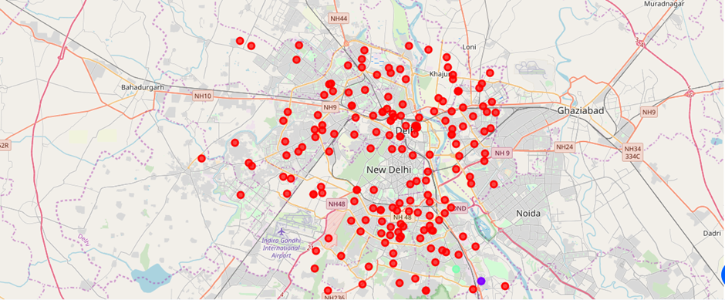
RESULTS
The results from the k-means clustering show that we can categorize the neighbourhoods into 3 clusters based on the frequency of occurrence for “Indian Sweet Shop”:
• Cluster 0: Neighbourhoods with maximum number of sweet shops
• Cluster 1: Neighbourhoods with low number of sweet shops
• Cluster 2: Neighbourhoods with low to no concentration of sweet shops
The results of the clustering are visualized in the map below with cluster 0 in red colour, cluster 1 in purple colour, and cluster 2 in mint green colour.

Slide 6
DISCUSSION
From the above results we can see that the locality having high number of sweet shops are located at very faraway places. Also it can be seen that the locality in
cluster 0 have large number of sweet shops available so opening a sweet shop in such place would lead you to survive a very tough competition resulting in less profit.
Cluster 1 and 2 have low to negligible sweet shops so opening sweet shop in such location would lead to fast growth and neither you have to go through high competition of market.

Slide 7
CONCLUSION
For this project we have gone through the business problem and have solved it by going through the process of data collection, data cleaning, data analysis, data preparation, data visualization, choosing and training the model and finally giving the results by categorising each location in three different cluster based on the frequency of sweet shop in the locality. Now answering the question, it is best to open the sweet shop in locations which fall under cluster 1 and 2 as these locations have minimal or no sweet shops in their locality.

Slide 8
THANK YOU

